Slide 1

Hardware Descriptive Language (HDL)
Lecture # 2
1

Slide 2
Motivation for HDL
Classical Design relied on
Schematics & Manual methods
But today
Computer Based Languages (HDL)
Because of the design circuits size & complexity
Language based designs
Independent of technology
Avoids the laborious steps involved in manual design
2

Slide 3
Cont’d…
HDL & Synthesis tool focus engr’s attention on
Functionality rather than gates
Synthesized ckt realize the desired functionality, area, performance constraints
Alternative architecture can be generated from the same HDL model & evaluated quickly to perform design tradeoffs.
3

Slide 4
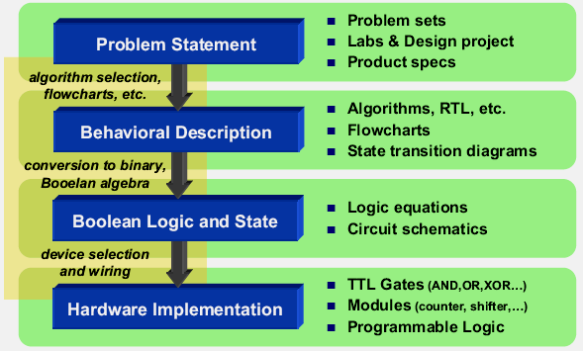
Building binary digital solutions to computational problems

Slide 5
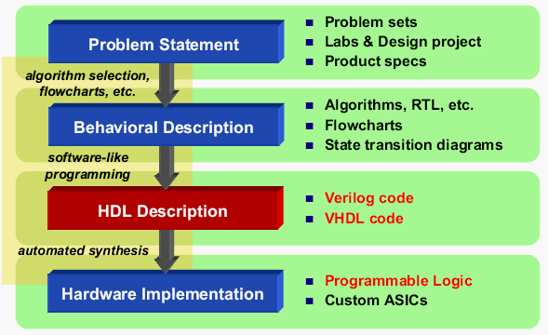
Logic synthesis using a Hardware Description Language (HDL) automates the most tedious and error-prone aspects of design

Slide 6
Why do we need HDLs ?
HDL can describe both circuit structure and behavior
Schematics describe only circuit structure
C language describes only behaviors
Provide high level abstraction to speed up design
High portability and readability
Enable rapid prototyping
Support different hardware styles
6

Slide 7
What do we need from HDLs ?
Describe
Combinational logic
Level sensitive storage devices
Edge-triggered storage devices
Support for hardware concurrency
7

Slide 8
HDLs
Verilog
Language style close to C/C++
Pre-defined data type, easy to use
VHDL
Language style close to Ada
User-defined data type, more flexible
Equally effective, personal preference
Both are supported by synthesis tool for ASIC & FPGAs
Both are IEEE Standards
Verilog has 60% of the world digital design market (larger share in US)
8

Slide 9
Verilog HDL

Slide 10
Verilog HDL Basics
Verilog was introduced in 1984 by Gateway Design System Corporation, now a part of Cadence Design Systems
Verilog-based synthesis tool introduced by Synopsys in 1987
Verilog HDL is a Hardware Description Language.
It describes the hardware. It is not a programming & procedural language.
Verilog HDL is a concurrent language
It enables specification of a digital system at a range of levels of abstraction:
Switches, Gates, RTL, and higher
Standard: IEEE 1364 in 1995

Slide 11
Event Driven Simulation
Verilog is really a language for modeling event driven systems
– Event : change in state
Simulation starts at t = 0
Processing events generates new events
When all events at time t have been processed simulation time advances to t+1
Simulation stops when there are no more events in the queue

Slide 12
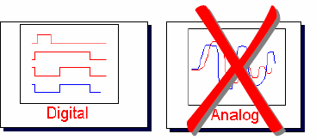
Basic Limitation of Verilog
Description of digital systems only

Slide 13
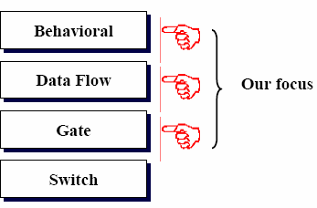
Abstraction Levels in Verilog

Slide 14
Switch-Level Modeling
This is the lowest level of abstraction provided by Verilog. A module can be implemented in terms of switches and the interconnections between them. Design at this level requires knowledge of switch-level implementation details (It’s rarely used). It is feasible for small circuits.
Gate Level Modeling
The module is implemented in terms of logic gates and interconnections between these gates. Design at this level is similar to describing a design in terms of a gate-level logic diagram. It is feasible for small circuits. Verilog supports basic logic gates as predefined primitives.
Dataflow Modeling
At this level, the module is designed by specifying the data flow. The designer is aware of how data flows between hardware registers and how the data is processed in the design.
Behavioral Modeling
This is the highest level of abstraction provided by Verilog HDL. A module can be implemented in terms of the desired design algorithm without concern for the hardware implementation details. Designing at this level is very similar to C programming.

